Slide 1




CS Bridge, Lecture 3 More Karel Control Flow

Slide 2


Learning Goals
Code using conditions
Trace programs that use loops and conditions
Decomposition and top-down design

Slide 3
Lecture Plan
Review: Karel and Control Flow
If/Else Statements
Decomposition and Top-Down Design
Practice: Hurdle Jumper

Slide 4
Lecture Plan
Review: Karel and Control Flow
If/Else Statements
Decomposition and Top-Down Design
Practice: Hurdle Jumper

Slide 5
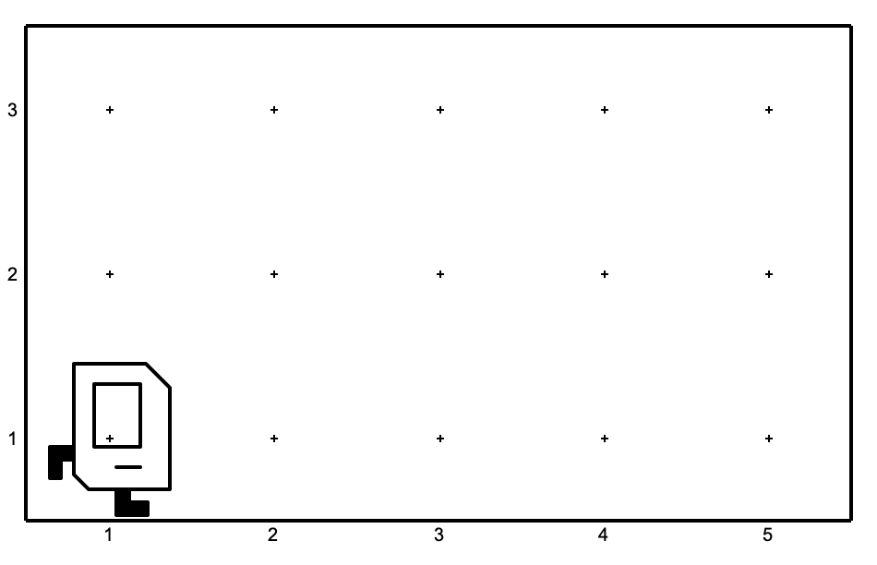
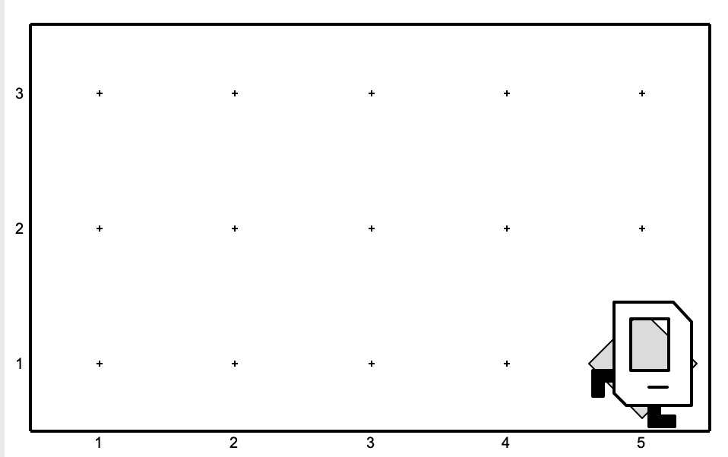
A quick question!
Which code will result in the following world?
def main():
while front_is_clear():
move()
put_beeper()
def main():
while front_is_clear():
move()
put_beeper()
(A)
(B)
Notes:
A

Slide 6
Indentation
Karel is very picky about indentation.
Make sure to indent a code block 1 level further when you:
Define a new Karel command
Write a for loop
Write a while loop
You may nest these. Make sure you keep track of your indentation!

Slide 7
Indentation
Karel is very picky about indentation.
for i in range(count):
statements # note indenting
def my_command():
for i in range(3):
turn_left()
put_beeper()

Slide 8
Control Flow
Control Flow lets us control the “flow” of our Karel program.
Example: repeat something 5 times
Example: repeat something until Karel is blocked

Slide 9
Control Flow: For Loops
Repeats the statements in the body count times:
for i in range(count):
statement
statement
...
Notes:
Executes statements in order – NOT repeating each one individually

Slide 10
Control Flow: While Loops
Repeats the statements in the body until condition is no longer true.
while condition:
statement
statement
...
Each time, Karel executes all statements, and then checks the condition.
Notes:
Karel can ask some questions about its world / surroundings

Slide 11
Possible Questions
Test | Opposite | What it checks
front_is_clear() | front_is_blocked() | Is there a wall in front of Karel?
left_is_clear() | left_is_blocked() | Is there a wall to Karel’s left?
right_is_clear() | right_is_blocked() | Is there a wall to Karel’s right?
beepers_present() | no_beepers_present() | Are there beepers on this corner?
facing_north() | not_facing_north() | Is Karel facing north?
facing_east() | not_facing_east() | Is Karel facing east?
facing_south() | not_facing_south() | Is Karel facing south?
facing_west() | not_facing_west() | Is Karel facing west?
This is taken from the Karel Reference.

Slide 12
Loops Overview
I want Karel to repeat some commands!
Know how many times
Don’t know how many times
for loop
while loop
Notes:
E.g. “pick up all the beepers on this square”
E.g. “turn until you’re facing west”
E.g. “put down 5 beepers”

Slide 13

Fencepost
I want Karel to put down a row of beepers until it reaches a wall. How do I do this?
Let’s first pretend the program must only work for this world. What commands should Karel execute?

Slide 14
Fencepost
I want Karel to put down a row of beepers until it reaches a wall. How do I do this?
put_beeper()
move()
put_beeper()
move()
put_beeper()
move()
put_beeper()

Slide 15

Fencepost
I want Karel to put down a row of beepers until it reaches a wall. How do I do this?
put_beeper()
move()
put_beeper()
move()
put_beeper()
move()
put_beeper()

Slide 16
Fencepost
I want Karel to put down a row of beepers until it reaches a wall. How do I do this?
put_beeper()
move()
put_beeper()
move()
put_beeper()
move()
put_beeper()

Slide 17
Fencepost
I want Karel to put down a row of beepers until it reaches a wall. How do I do this?
put_beeper()
move()
put_beeper()
move()
put_beeper()
move()
put_beeper()

Slide 18
Fencepost
I want Karel to put down a row of beepers until it reaches a wall. How do I do this?
put_beeper()
move()
put_beeper()
move()
put_beeper()
move()
put_beeper()

Slide 19
Fencepost
I want Karel to put down a row of beepers until it reaches a wall. How do I do this?
put_beeper()
move()
put_beeper()
move()
put_beeper()
move()
put_beeper()

Slide 20
Fencepost
I want Karel to put down a row of beepers until it reaches a wall. How do I do this?
put_beeper()
move()
put_beeper()
move()
put_beeper()
move()
put_beeper()

Slide 21
Fencepost
I want Karel to put down a row of beepers until it reaches a wall. How do I do this?
put_beeper()
move()
put_beeper()
move()
put_beeper()
move()
put_beeper()

Slide 22
Fencepost
I want Karel to put down a row of beepers until it reaches a wall. How do I do this?
put_beeper()
move()
put_beeper()
move()
put_beeper()
move()
put_beeper()
We must put 4 beepers but move 3 times!

Slide 23
Fencepost
I want Karel to put down a row of beepers until it reaches a wall. How do I do this?
We must put 4 beepers but move 3 times!
while front_is_clear():
put_beeper()
move()
put_beeper()

Slide 24
Fencepost
I want Karel to put down a row of beepers until it reaches a wall. How do I do this?
while front_is_clear():
put_beeper()
move()
put_beeper()

Slide 25
Fencepost
I want Karel to put down a row of beepers until it reaches a wall. How do I do this?
while front_is_clear():
put_beeper()
move()
put_beeper()

Slide 26
Fencepost
I want Karel to put down a row of beepers until it reaches a wall. How do I do this?
while front_is_clear():
put_beeper()
move()
put_beeper()

Slide 27
Fencepost
I want Karel to put down a row of beepers until it reaches a wall. How do I do this?
while front_is_clear():
put_beeper()
move()
put_beeper()

Slide 28
Fencepost
I want Karel to put down a row of beepers until it reaches a wall. How do I do this?
while front_is_clear():
put_beeper()
move()
put_beeper()

Slide 29
Fencepost
I want Karel to put down a row of beepers until it reaches a wall. How do I do this?
while front_is_clear():
put_beeper()
move()
put_beeper()

Slide 30
Fencepost
I want Karel to put down a row of beepers until it reaches a wall. How do I do this?
while front_is_clear():
put_beeper()
move()
put_beeper()

Slide 31
Fencepost
I want Karel to put down a row of beepers until it reaches a wall. How do I do this?
while front_is_clear():
put_beeper()
move()
put_beeper()

Slide 32
Fencepost
I want Karel to put down a row of beepers until it reaches a wall. How do I do this?
while front_is_clear():
put_beeper()
move()
put_beeper()

Slide 33
Fencepost
I want Karel to put down a row of beepers until it reaches a wall. How do I do this?
while front_is_clear():
put_beeper()
move()
put_beeper()

Slide 34
Fencepost
I want Karel to put down a row of beepers until it reaches a wall. How do I do this?
while front_is_clear():
put_beeper()
move()
put_beeper()

Slide 35
Fencepost
I want Karel to put down a row of beepers until it reaches a wall. How do I do this?
while front_is_clear():
put_beeper()
move()
put_beeper()

Slide 36
Fencepost
I want Karel to put down a row of beepers until it reaches a wall. How do I do this?
while front_is_clear():
put_beeper()
move()
put_beeper()

Slide 37
Fencepost
I want Karel to put down a row of beepers until it reaches a wall. How do I do this?
put_beeper()
move()
put_beeper()
move()
...
put_beeper()
We must put N beepers but move N-1 times!

Slide 38
Fencepost
I want Karel to put down a row of beepers until it reaches a wall. How do I do this?
put_beeper()
move()
put_beeper()
move()
put_beeper()
move()
put_beeper()

Slide 39
Fencepost
I want Karel to put down a row of beepers until it reaches a wall. How do I do this?
put_beeper()
move()
put_beeper()
move()
put_beeper()
move()
put_beeper()

Slide 40
Fencepost
I want Karel to put down a row of beepers until it reaches a wall. How do I do this?
put_beeper()
while front_is_clear():
move()
put_beeper()

Slide 41
Fencepost
I want Karel to put down a row of beepers until it reaches a wall. How do I do this?
put_beeper()
move()
put_beeper()
move()
put_beeper()
...
move()
put_beeper()
We must put N beepers but move N-1 times!

Slide 42

Fencepost Problem
8 fence segments, but 9 posts!

Slide 43
Fencepost Structure
The fencepost structure is useful when you want to loop a set of statements but do one part of that set 1 additional time.
put_beeper() # post
while front_is_clear():
move() # fence
put_beeper() # post
# or...
while front_is_clear():
put_beeper() # post
move() # fence
put_beeper() # post

Slide 44
Lecture Plan
Review: Karel and Control Flow
If/Else Statements
Decomposition and Top-Down Design
Practice: Hurdle Jumper

Slide 45
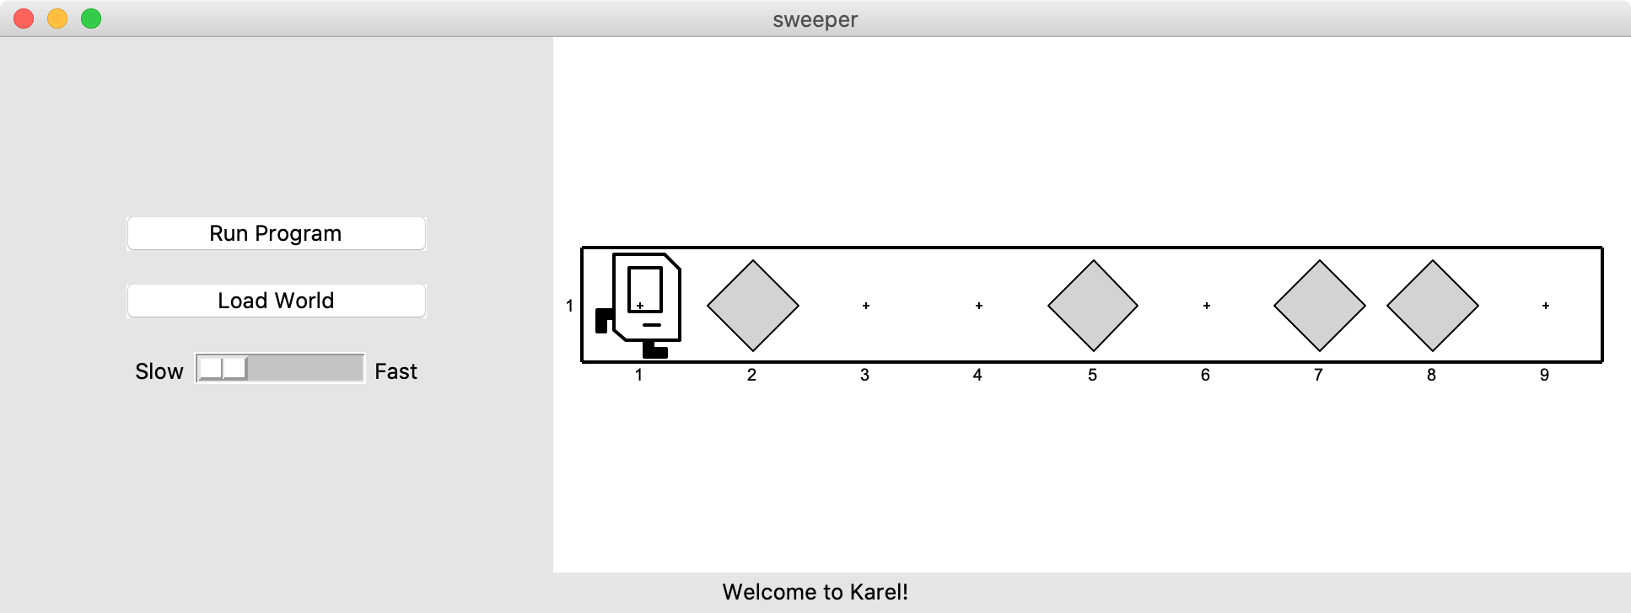
If Statements
I want to make Karel clean up all beepers in front of it until it reaches a wall. How do I do this?

Slide 46
If Statements
Will this work?
while front_is_clear():
move()
pick_beeper()
No. This may crash, because Karel cannot pick up beepers if there aren’t any. We don’t always want Karel to pick up beepers; just when there is a beeper to pick up.

Slide 47
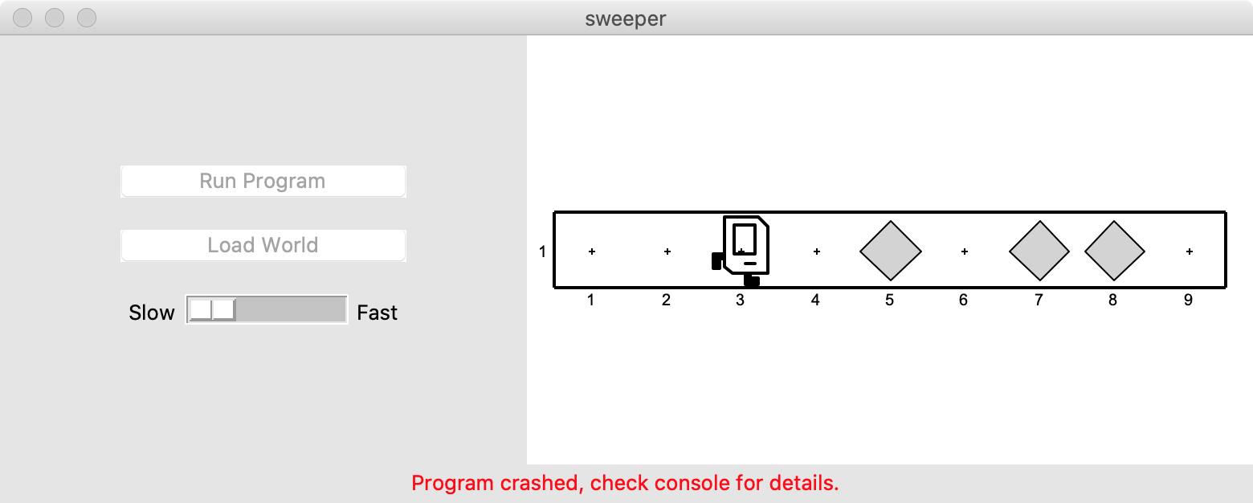

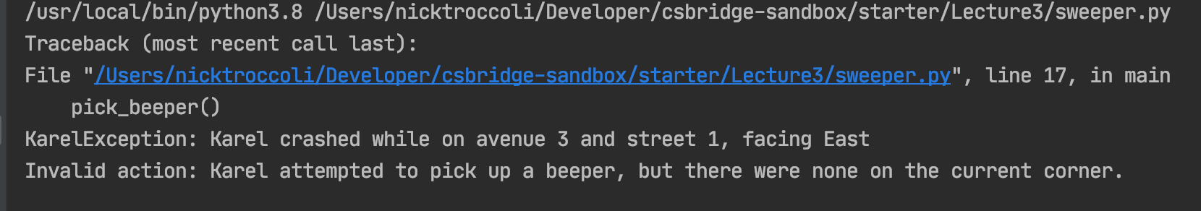
If Statements
Notes:
Who has seen this before?

Slide 48
If Statements
Instead, use an if statement:
if condition:
statement
statement
...
Runs the statements in the body once if condition is true. These are the same conditions you can use for while loops!
Notes:
If does it 0 or 1 time. While does it 0 or more times

Slide 49
If Statements
Now we can say:
while front_is_clear():
move()
if beepers_present():
pick_beeper()
Karel won’t crash because it will only pick up a beeper if there is one.

Slide 50
If Statements and Indentation
if condition:
statements # note indenting
def safe_pick_up():
if beepers_present():
pick_beeper() # note indenting
Notes:
Pause for questions

Slide 51
If/Else Statements
What if we want to do one thing if some condition is true, and another otherwise? We can add an else statement:
if condition:
statement
statement
...
else:
statement
statement
...
This will run the first group of statements if condition is true; otherwise, it runs the second group of statements.

Slide 52
If/Else Statements
What does this code do?
def main():
if beepers_present():
pick_beeper()
else:
put_beeper()
Notes:
Inverts beepers

Slide 53
If/Else Statements and Indentation
if condition:
statements # note indenting
else:
statements # note indenting
def invert_beepers():
if beepers_present():
pick_beeper() # note indenting
else:
put_beeper() # note indenting

Slide 54
Karel and Control Flow
Congratulations! You’ve learned all of control flow in Karel.
Control Flow lets us control the “flow” of our Karel program. For example, repeat something more than once, or only do something in certain cases.
Want to repeat something? Use a for or while loop.
- for if we know how many times
- while if we don’t know how many times
Want to conditionally do something? Use if (with an optional else)

Slide 55
Lecture Plan
Review: Karel and Control Flow
If/Else Statements
Decomposition and Top-Down Design
Practice: Hurdle Jumper

Slide 56
Decomposition
Breaking down problems into smaller, more approachable sub-problems (e.g. our own Karel commands)

Slide 57
Top-Down Design
Start from a large task and break it up into smaller pieces
Ok to write your program in terms of commands that don’t exist yet
Goal: make our programs easily readable by humans
Commenting
Decomposition

Slide 58
Decomposition and Top-Down Design
E.g. You wake up and and trying to plan your day
Approach 1
Get left foot out of bed
Get right foot out of bed
Stand up
Move to washroom
Grab brush
Apply toothpaste
Brush teeth
Get face wash
Scrub on face
Exit washroom
Go to kitchen
Crack eggs
…

Slide 59
Decomposition and Top-Down Design
E.g. You wake up and and trying to plan your day
Approach 1
Get left foot out of bed
Get right foot out of bed
Stand up
Move to washroom
Grab brush
Apply toothpaste
Brush teeth
Get face wash
Scrub on face
Exit washroom
Go to kitchen
Crack eggs
…
Approach 2
Get out of bed
Wash up
Eat breakfast

Slide 60
Decomposition and Top-Down Design
E.g. You wake up and and trying to plan your day
Approach 1
Get left foot out of bed
Get right foot out of bed
Stand up
Move to washroom
Grab brush
Apply toothpaste
Brush teeth
Get face wash
Scrub on face
Exit washroom
Go to kitchen
Crack eggs
…
Approach 2
Get out of bed
Exit bed
Stand up
Wash up
Eat breakfast

Slide 61
Decomposition and Top-Down Design
E.g. You wake up and and trying to plan your day
Approach 1
Get left foot out of bed
Get right foot out of bed
Stand up
Move to washroom
Grab brush
Apply toothpaste
Brush teeth
Get face wash
Scrub on face
Exit washroom
Go to kitchen
Crack eggs
…
Approach 2
Get out of bed
Exit bed
Stand up
Wash up
Brush teeth
Wash face
Eat breakfast

Slide 62
Decomposition and Top-Down Design
E.g. You wake up and and trying to plan your day
Approach 1
Get left foot out of bed
Get right foot out of bed
Stand up
Move to washroom
Grab brush
Apply toothpaste
Brush teeth
Get face wash
Scrub on face
Exit washroom
Go to kitchen
Crack eggs
…
Approach 2
Get out of bed
Exit bed
Stand up
Wash up
Brush teeth
Wash face
Eat breakfast
Make eggs
Pour juice
Eat

Slide 63
Decomposition and Top-Down Design
Breaking down problems into smaller, more approachable sub-problems (e.g. our own Karel commands)
Each piece should solve one problem/task (< ~ 20 lines of code)
Descriptively-named
Well-commented!
Problems should be solved top-down.

Slide 64
Commenting with Pre/Post-Conditions
Precondition: something you assume is true at the start of a function or code block
Postcondition: something you promise is true at the end of a function or code block
Pre/post-conditions should be documented using comments.
def jump_hurdle(): """ Karel jumps over one hurdle of arbitrary height. Pre-condition: Karel is facing east next to a hurdle. Post-condition: Karel is facing east at the bottom of the other side of the hurdle. """ ascend_hurdle() move() descend_hurdle()

Slide 65
Lecture Plan
Review: Karel and Control Flow
If/Else Statements
Decomposition and Top-Down Design
Practice: Hurdle Jumper

Slide 66
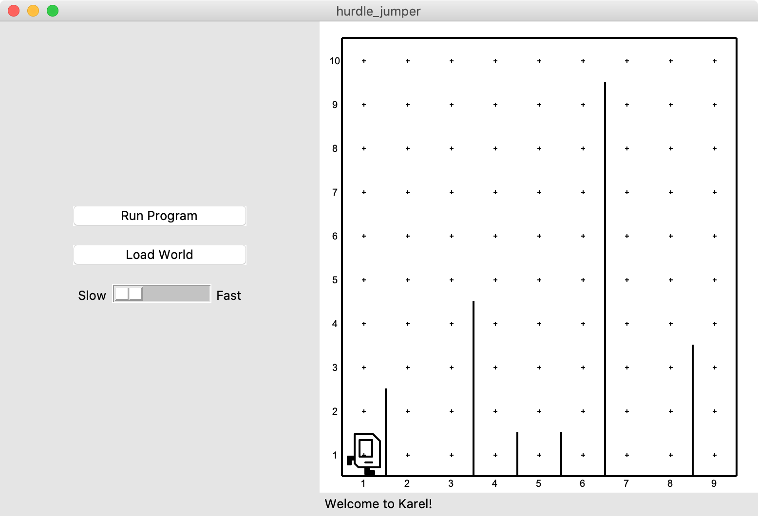
Hurdle Jumper
Karel is in the Olympics! We want to write a Karel program that hops hurdles.
Karel starts at (1,1) facing East and should end up at the end of row 1 facing east.
The world has 9 columns.
There are an unknown number of ”hurdles” (walls) of varying heights that Karel must ascend and descend to get to the other side.

Slide 67
Hurdle Jumper
Demo

Slide 68
Lecture Recap
Review: Karel and Control Flow
If/Else Statements
Decomposition and Top-Down Design
Practice: Hurdle Jumper

Slide 69

Karel Resources

Slide 70
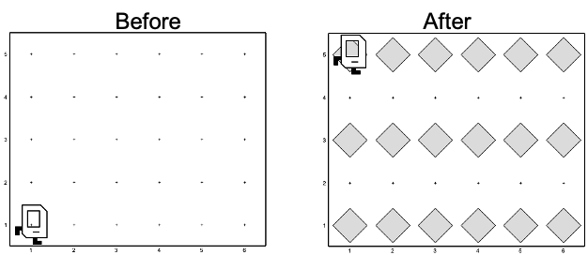
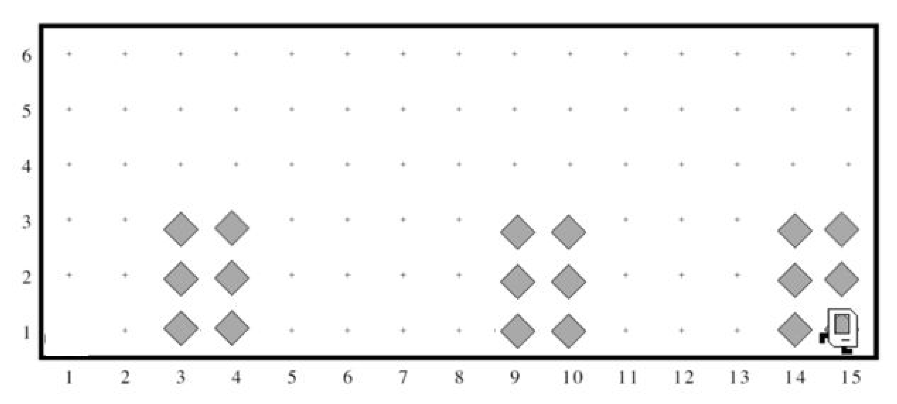
Rest Of Today
Quickstart: Implement a program where Karel draws stripes with Beepers.
Section: Implement a program where Karel builds Hospitals
Project: Write a program where Karel paints any world randomly with green and blue squares.

Slide 71
What’s Next?
Time for your section’s quickstart time!
Check your section’s Ed group for more information

